Slide 1

HOT TOPICS IN PROPER
WAGE & HOUR COMPLIANCE
An informative review and update on the various laws regulating
minimum wage and overtime issues.
WEBINAR: MAY 23, 2017
The executive, professional and administrative overtime exemptions.
When overtime is or is not required under the law.
Basic employer compliance in connection with wage and hour law.
Penalties an employer faces when it fails to correctly pay the minimum wage and overtime to employees.
A religious institution’s possible exemption from federal or state wage and hour law.
Presented By:
Jonathan D. Farrell, Esq.
Meltzer, Lippe, Goldstein & Breitstone, LLP
Mineola, New York
516.747.0300 Ext. 130
jfarrell@meltzerlippe.com
www.meltzerlippe.com

Slide 2
HOT TOPICS IN PROPER WAGE & HOUR COMPLIANCE
Presented by:
Jonathan D. Farrell, Esq.
Meltzer, Lippe, Goldstein & Breitstone, LLP

Slide 3



Slide 4
PART I –THE FEDERAL AND STATE WAGE/HOUR LAWS – OVERVIEW
A. The federal Fair Labor Standards Act (FLSA) (29 U.S.C. §§201 et.seq.) sets minimum wage, overtime pay, recordkeeping, and youth employment standards for employment. Unless exempt, covered employees must be paid at least the minimum wage and not less than one and one-half times their regular rates of pay for overtime hours worked.
B. New York State Wage Hour Law (NYS Labor Law §§650 et.seq. and 12 NYCRR §§137 et.seq.) also provides for minimum wage, overtime pay, recordkeeping, and youth employment standards for employment. Other areas address employee benefits and employee notice requirements as discussed below.
C. Akin to federal and state discrimination laws, the law that is more favorable to employees must be followed by employers.
D. Both laws set a minimum wage. On April 4, 2016 New York Governor Andrew Cuomo signed a law which will significantly increase the New York State minimum wage to $15.00 per hour over a two (2) to five (5) year period, depending upon certain factors, such as the employer’s size and location. Please see the revised increases as enacted in the table below:

Slide 5
REVISED INCREASES
Date | New York City “Large” Business (11 employees or more) | New York City “Small” Business (10 employees or less) | Nassau, Suffolk and Westchester Counties | Rest of State
12/31/2016 | $11.00 | $10.50 | $10.00 | $9.70
12/31/2017 | $13.00 | $12.00 | $11.00 | $10.40
12/31/2018 | $15.00 | $13.50 | $12.00 | $11.10
12/31/2019 | TBD | $15.00 | $13.00 | $11.80
12/31/2020 | TBD | TBD | $14.00 | $12.50
12/31/2021 | TBD | TBD | $15.00 | TBD

Slide 6
PART I –THE FEDERAL AND STATE WAGE/HOUR LAWS – OVERVIEW
E. Both laws require payment of overtime for “non-exempt” employees (discussed below), at the rate of 1½ times the regular hourly wages for those hours worked in excess of 40 within a workweek. Although mandated in some states, the FLSA and NYS Law impose no obligation to pay overtime on a daily basis nor does it mandate overtime on a 6th or 7th day of work.
F. Both laws have statute of limitations. Under the FLSA it is 2 years for non-willful violations and 3 years for willful violations. Under NYS Law, it is 6 years.
G. Under the FLSA, a prevailing plaintiff is also entitled to liquidated damages of 100%, interest and attorney fees.
H. Under NYS Law a prevailing plaintiff is entitled to 25% liquidated damages for violations occurring before April 9, 2011. Violations that occur after that date are subject to 100% liquidated damages as well as interest and attorney fees.

Slide 7
PART I –THE FEDERAL AND STATE WAGE/HOUR LAWS – OVERVIEW
I. The United States Department of Labor (“the USDOL”) enforces the FLSA. USDOL audits - whether employee complaint driven or otherwise – generally will require the employer to show payroll records for all employees.
J. The New York State Department of Labor (“the NYSDOL”) enforces the New York State Labor Laws. NYSDOL audits - whether employee complaint driven or otherwise – generally will require the employer to show payroll records for all employees.
K. Both statutes are designed to permit private party litigation in federal or state court in lieu of USDOL or NYSDOL actions. Both statutes permit multiple plaintiff action (FLSA - collective; NYS - class).
L. Employers must display an official USDOL poster outlining the provisions of the FLSA. Likewise, employers must also display the New York State’s Minimum Wage Information poster in their place of work. Other federal and state posters addressing different laws (e.g., discrimination) must also be displayed at the workplace.

Slide 8
PART II – STATUTORY FRAMEWORK
A. Coverage Under The FLSA
1.Enterprise Coverage
Employees who work for certain businesses or organizations (or "enterprises") are covered by the FLSA. These enterprises, which must have at least two employees, are:
(a) those that have an annual dollar volume of sales or business done of at least $500,000; or
(b) hospitals, businesses providing medical or nursing care for residents, schools and preschools, and government agencies.

Slide 9
PART II – STATUTORY FRAMEWORK
2. Individual Coverage
Even when there is no “enterprise coverage”, employees are protected by the FLSA if their work regularly involves them in commerce between States ("interstate commerce"). The FLSA covers individual workers who are "engaged in commerce or in the production of goods for commerce."
Examples of employees who are involved in interstate commerce include those who: produce goods (such as a worker assembling components in a factory or a secretary typing letters in an office) that will be sent out of state, regularly make telephone calls to persons located in other States, handle records of interstate transactions, travel to other States on their jobs, and do janitorial work in buildings where goods are produced for shipment outside the State. Also, domestic service workers (such as housekeepers, full-time babysitters, and cooks) are normally covered by the law.

Slide 10
Under FLSA,
What Records Are Required:
B. Under FLSA, What Records Are Required:
Every covered employer must keep certain records for each non-exempt worker. The FLSA requires no particular form for the records, but does require that the records include certain accurate identifying information about the employee and data about the hours worked and the wages earned. The following is a listing of the basic records that an employer must maintain:
Employee's full name and social security number.
Address, including zip code.
Birth date, if younger than 19.
Sex and occupation.
Time and day of week when employee's workweek begins.
Hours worked each day.
7. Total hours worked each workweek.

Slide 11
Under FLSA,
What Records Are Required:
Basis on which employee's wages are paid (e.g., "$9 per hour", "$440 a week", "piecework")
Regular hourly pay rate.
Total daily or weekly straight-time earnings.
11. Total overtime earnings for the workweek.
All additions to or deductions from the employee's wages.
Total wages paid each pay period.
14. Date of payment and the pay period covered by the payment.

Slide 12
Under FLSA,
What Records Are Required:
New York requires similar records plus, the employer must maintain: number of hours worked daily and weekly, including the time of arrival and departure of each employee working a split shift or spread of hours (discussed below) exceeding 10 hours; allowances, if any, claimed as part of the minimum wage; net wages paid; and student classification.

Slide 13
How Long Should Records Be Retained Under The FLSA?
C. How Long Should Records Be Retained Under The FLSA:
Each employer shall preserve for at least three (3) years payroll records, collective bargaining agreements, sales and purchase records. Time and earning cards or sheets on which are entered the daily starting and stopping time of employees are to be preserved for two (2) years. 29 C.F.R. §516.6
New York has a longer payroll record retention statute (see immediately below).

Slide 14
How Long Should Records Be Retained Under New York Law?
D. How Long Should Records Be Retained Under New York Law:
New York’s payroll record retention period is six (6) years but certain labor counsel recommend longer retention of records than mandated by the statute due to the breadth of New York State’s statute of limitations statute.

Slide 15
Compensable Time Under The FLSA
E. Compensable Time Under The FLSA
1.General: The FLSA requires employers to pay a minimum wage of $7.25 per hour (NYS Law minimum wage was the same through December 31, 2013 but currently is higher) for all hours worked plus overtime compensation at a rate of 1½ times the regular rate of pay for hours worked in excess of forty (40) per work week. New York based employers must currently pay at least the following regular rate per hour:
$11.00 “large” businesses in New York City; $10.50 “small” businesses in New York City; $10.00 employers in Nassau, Suffolk and Westchester Counties; and $9.70 rest of New York State.
An employee's workweek is a fixed and regularly recurring period of 168 hours (7 consecutive 24-hour periods).

Slide 16
Compensable Time Under The FLSA
2. Hours worked: Hours worked includes any and all time that an employee has been "suffered or permitted" to work. Work is "suffered or permitted" if the employer knows or has reason to know that the work is being performed. The employee must be compensated for all such work regardless of whether the employer directed or approved the work or even if the employer has a policy prohibiting unauthorized work.
3. Waiting Time: Waiting time may be deemed “hours worked” under the FLSA depending upon the particular circumstances. Generally, the facts may show that the employee was engaged to wait (which is work time) or the facts may show that the employee was waiting to be engaged (which is not work time). For example, a secretary who reads a book while waiting for dictation or a fireman who plays checkers while waiting for an alarm is working during such periods of inactivity. These employees have been "engaged to wait."

Slide 17
Compensable Time Under The FLSA
4. On-Call Time: An employee who is required to remain “on call” on the employer's premises is working while "on call." An employee who is required to remain on call at home, or who is allowed to leave a message where he/she can be reached, is not working (in most cases) while on call. Additional constraints on the employee's freedom could require this time to be compensated.
5. Rest and Meal Periods: Rest periods of short duration, usually 20 minutes or less must be counted as hours worked. Meal periods (typically 30 minutes or more) generally need not be compensated as work time. The employee must be completely relieved from duty for the purpose of eating regular meals. The employee is not relieved if he/she is required to perform any duties, whether active or inactive, while eating.
On a related note, New York State Labor Law Section 162 (and the NYSDOL’s interpreting regulations) provides employees are entitled to a 30-minute lunch break between 11:00 a.m. and 2:00 p.m. for shifts six hours or longer that extend over that period. Consistent with the FLSA, such meal period need not be treated as “hours worked” and compensated.

Slide 18
Compensable Time Under The FLSA
6. Lectures, Meetings and Training Programs: Attendance at lectures, meetings, training programs and similar activities need not be counted as working time only if four criteria are met, namely: it is outside normal hours, it is voluntary, not job related, and no other work is concurrently performed. Otherwise, they should be counted as “hours worked.”
7. Travel Time: The principles which apply in determining whether time spent in travel is compensable time depends upon the kind of travel involved. An employee who travels from home before the regular workday and returns to his/her home at the end of the workday is engaged in ordinary home to work travel, which is not work time (and thus, not compensable). An employee who regularly works at a fixed location in one city is given a special one day assignment in another city and returns home the same day. The time spent in traveling to and returning from the other city is work time, except that the employer may deduct (not count) that time the employee would normally spend commuting to the regular work site.

Slide 19
Compensable Time Under The FLSA
Travel Time (cont’d)
Time spent by an employee in travel as part of their principal activity, such as travel from job site to job site during the workday, is work time and must be counted as hours worked.
Travel that keeps an employee away from home overnight is travel away from home. Travel away from home is clearly work time when it cuts across the employee's workday. The time is not only hours worked on regular working days during normal working hours but also during corresponding hours on nonworking days. As an enforcement policy the USDOL will not consider as work time that time spent in travel away from home outside of regular working hours as a passenger on an airplane, train, boat, bus, or automobile.

Slide 20
Compensable Time Under The FLSA
Travel Time (cont’d)
Time spent by an employee in travel as part of their principal activity, such as travel from job site to job site during the workday, is work time and must be counted as hours worked.
Travel that keeps an employee away from home overnight is travel away from home. Travel away from home is clearly work time when it cuts across the employee's workday. The time is not only hours worked on regular working days during normal working hours but also during corresponding hours on nonworking days. As an enforcement policy the USDOL will not consider as work time that time spent in travel away from home outside of regular working hours as a passenger on an airplane, train, boat, bus, or automobile.

Slide 21
Compensable Time Under The FLSA
F. Employee/Independent Contractor
Unlike employees, independent contractors are not entitled to the protections of the FLSA and New York State Labor Law. See below discussion regarding the test for determining who is an independent contractor.
G. Individuals Who Are Exempt From The Overtime Provisions
of the Law
Executive, Administrative and Professional Exemptions
(a/k/a “White Collar”)
a. Salary Basis Test
To qualify for the executive and administrative exemptions - and thus, be exempt from the overtime provisions of the law - an employee must be paid on a “salary basis” which weekly salary is established by federal and NYS Law AND meet the requirements of the specific exemption. Merely paying an employee an established weekly salary is not sufficient to be exempt under FLSA or NYS Law.
Importantly, in 2014 President Obama executed a “Presidential Memorandum” which directed the United States Department of Labor (“USDOL”) to update the FLSA’s regulations defining which white collar workers are protected by the FLSA’s minimum wage and overtime standards.

Slide 22
Compensable Time Under The FLSA
On May 18, 2016 and after consideration of the aforementioned written comment, President Obama and the then USDOL Secretary Thomas Perez announced the publication of the USDOL’s “final rule” updating, amongst other things, the “white collar” exemptions to the FLSA. The May 18, 2016 announcement focused, primarily, on updating the salary and compensation levels needed for executive, administrative and professional workers to be exempt. Specifically, the final rule:
•Sets the standard salary threshold level at $913.00 per week; $47,476.00 annually for a full-year worker (based on the 40th percentile of earnings of full-time salaried workers in the lowest-wage Census Region, currently the South);
•Sets the total annual compensation requirement for highly compensated employees at $134,004.00; (based on the 90th percentile of full-time salaried workers nationally);
•Establishes a mechanism for automatically updating the salary and compensation levels every three years to maintain the levels at the above percentiles; and,
•Amends the salary basis test to allow employers to use nondiscretionary bonuses and incentive payments (including commissions) to satisfy up to ten percent (10%) of the new standard salary level.

Slide 23
Compensable Time Under The FLSA
The below chart sets forth the aforementioned scheduled increases to the New York weekly salary threshold for salaried employees:
Date | New York City “Large” Business (11 employees or more) | New York City “Small” Business (10 employees or less) | Nassau, Suffolk and Westchester Counties | Rest of State
12/31/16 | $825.00 | $787.50 | $750.00 | $727.50
12/31/17 | $975.00 | $900.00 | $825.00 | $780.00
12/31/18 | $1,125.00 | $1,012.50 | $900.00 | $832.50
12/31/19 | TBD | $1,125.00 | $975.00 | $885.00
12/31/20 | TBD | TBD | $1,050.00 | $937.50
12/31/21 | TBD | TBD | $1,125.00 | TBD

Slide 24
EXECUTIVE EXEMPTION
An exempt employee’s receipt of additional compensation above her/his salary does not affect the exemption. In this regard, federal regulation 29 C.F.R. 541.604 states, in pertinent part:
An employer may provide an exempt employee with additional compensation without losing the exemption or violating the salary basis requirement, if the employment arrangement also includes a guarantee of at least the minimum weekly-required amount paid on a salary basis. . . . Similarly, the exemption is not lost if an exempt employee who is guaranteed at least $455 each week paid on a salary basis also receives additional compensation based on hours worked for work beyond the normal workweek.
Such additional compensation may be paid on any basis (e.g., flat sum, bonus payment, straight-time hourly amount, time and one-half or any other basis), and may include paid time off.

Slide 25
EXECUTIVE EXEMPTION
Executive Exemption:
To qualify for the Executive exemption an employee must:
have a primary duty of managing the enterprise or managing a customarily recognized department or subdivision of the enterprise;
customarily and regularly direct the work of two (2) or more other full-time employees or their equivalent; and
have the authority to hire or fire other employees (or make recommendations as to hiring, firing, promotion, or other change of status of other employees).

Slide 26
ADMINISTRATIVE EXEMPTION
Administrative Exemption:
To qualify for the Administrative exemption an employee must:
have the primary duty of performing office or non-manual work directly related to the management or general business operations of the employer or its customers; and
have a primary duty of exercising discretion and independent judgment with respect to matters of significance.
"Directly related to management or general business operations" means work directly related to assisting with the running or servicing of a business, such as work in functional areas such as tax, finance, accounting, budgeting, auditing, insurance, quality control, purchasing, procurement, advertising, marketing, research, safety and health, personnel management, human resources, employee benefits, labor relations, public relations, government relations, computer network, internet and database administration, legal and regulatory compliance, and similar activities.

Slide 27
ADMINISTRATIVE EXEMPTION
Administrative Exemption:
An exempt administrative employee also must exercise discretion and independent judgment with respect to matters of significance. Mere risk of financial loss to the business is insufficient. Exercising discretion and independent judgment involves the comparison and evaluation of possible courses of conduct, and acting or making a decision after the various possibilities have been considered. The term "matters of significance" refers to the level of importance or consequence of the work performed. Employees can exercise "discretion and independent judgment" even if their decisions or recommendations are reviewed at a higher level. Discretion and independent judgment mean more than the use of skill in applying well-established techniques, procedures, or specific standards described in manuals or other sources.
Job titles are not, in and of themselves dispositive. The actual duties performed are dispositive for the exemption. Generally, insurance adjusters, financial services employees, executive or administrative assistants to business owners or senior executives, human resources managers, and purchasing agents generally meet the duty requirements of the administrative exemption.

Slide 28
PROFESSIONAL EXEMPTION
Professional Exemption:
There are two general types of exempt professional employees:
  learned professionals and
  creative professionals

Slide 29
PROFESSIONAL EXEMPTIONS
(i) LEARNED PROFESSIONAL:
To qualify for the learned professional employee exemption, all of the following tests must be met:
The employee must be compensated on a salary or fee basis (as defined in the regulations) at a rate not less than $455 per week;
The employee’s primary duty must be the performance of work requiring advanced knowledge, defined as work which is predominantly intellectual in character and which includes work requiring the consistent exercise of discretion and judgment;
The advanced knowledge must be in a field of science or learning; and
The advanced knowledge must be customarily acquired by a prolonged course of specialized intellectual instruction.

Slide 30
PROFESSIONAL EXEMPTION
(ii) CREATIVE PROFESSIONAL:
To qualify for the creative professional employee exemption, all of the following tests must be met:
The employee must be compensated on a salary or fee basis (as defined in the regulations) at a rate not less than $455 per week;
The employee’s primary duty must be the performance of work requiring invention, imagination, originality or talent in a recognized field of artistic or creative endeavor.

Slide 31
PROFESSIONAL EXEMPTIONS
HIGHLY COMPENSATED EMPLOYEES
An individual who is paid a salary and has total compensation of $100,000.00 or more will be exempt if they regularly perform one or more of the exempt duties or responsibilities of an executive or administrative or professional employee and whose primary duty is the performance of non-manual work.
COMPUTER EMPLOYEE EXEMPTION
To qualify for the computer employee exemption, the following tests must be met:
The employee must be compensated either on a salary or fee basis at a rate not less than $455 per week or, if compensated on an hourly basis, at a rate not less than $27.63 an hour;
The employee must be employed as a computer systems analyst, computer programmer, software engineer or other similarly skilled worker in the computer field

Slide 32
PROFESSIONAL EXEMPTIONS
OUTSIDE SALES EMPLOYEES
These individuals are exempt provided they satisfy the following;
•Their primary duty is making sales or obtaining orders or contract for services or facilities for which a consideration will be paid by the client or customers, and
•They are customarily and regularly engaged away from the employer's place(s) of business.
COMMISSIONED SALESPERSONS (INSIDE SALES)
Section 7(i) of the FLSA exempts commissioned salespersons from the overtime requirements provided that the following three criteria are met:
•The individual must earn more in commissions than in non-commission income for a pre-determined representative period of not less than one month. Non-commission income includes salary, guaranteed draw and other salary-like payments.
•There must be proof that the individual receives compensation (commissions, base pay and other compensation) that equals or exceeds time and one-half of the federal minimum wage for all hours of work (1.5 x $7.25 = $10.875).

Slide 33
PROFESSIONAL EXEMPTIONS
MINISTERIAL EXEMPTION
These individuals are exempt provided they satisfy the following criteria:
• The religious institution made its decision to hire the individual based largely on religious principles. Individuals who are ordained, members of the clergy, pastors, and ministers generally meet this criterion.
• The individual must be a spiritual leader whose duties are ministerial or religious in nature (i.e. performs ceremonies of the church, spreads the faith, and serves pursuant to religious obligations).
• The individual engages in ecclesiastical or religious activities and attends to the religious needs of the faithful as part of the job function.

Slide 34
PROFESSIONAL EXEMPTIONS
LOSS OF EXEMPT STATUS
An individual who falls within an overtime exemption and is paid a salary as set forth above may lose the exemption if improper deductions from the salary are made. Such improper deductions generally include:
absences of less than one (1) day even if such partial day absence is for personal reasons;
absences caused by the employer for lack of work or;
disciplinary reasons not involving a major safety rule infraction.

Slide 35
PROFESSIONAL EXEMPTIONS
DETERTMINING OVERTIME COMPENSATION
1. Regular rate
An employee's regular rate, and the basis on which overtime is calculated, is ordinarily the employee's standard hourly rate of pay. However, where additional compensation via commissions, piecework, production bonuses or retroactive raises are received, said monies must be added to the standard hourly rate to determine the regular rate for any weekly period.
By the same token certain monies given to employees need not be considered part of an employee's regular rate. They include;
• gifts (e.g., Christmas bonus) as a reward for service which are not measured by or dependent on hours, production or efficiency;
• vacation, holiday and sick payments (all can be designated as non- work time for overtime purposes. In other words, overtime occurs after 40 hours worked – not 40 hours paid);
• reimbursements;
• discretionary bonuses (if both the fact and amount are discretionary); and
• contributions to a trustee or third person, per bona fide plan, for retirement.

Slide 36
PROFESSIONAL EXEMPTIONS
2. COMPENSATORY TIME OFF
In the private sector, compensatory time is only permitted if taken within the same pay workweek in which earned.
When compensatory time off is given to an employee outside the workweek period, it is usually at the employee's regular rate instead of the statutory time and one half rate, (e.g., if employee had 45 hours of work in one pay period and was permitted to take off 5 hours with pay in a subsequent period – rather than be paid for these additional hours at an overtime rate - the employee was shorted 5 hours at half time). Given this problem, private sector employers should only pay overtime wages – and not provide compensatory time off in lieu of overtime.
J. For more information regarding the New York State’s minimum wage rates; tipped, uniform maintenance, meal, and lodging allowances; and exempt employee weekly salary requirement, please refer to the New York State Department of Labor - Summary of Wage Order Rates and Allowances For Miscellaneous Industries and Occupations (effective December 31, 2016), which is annexed hereto.

Slide 37
PROFESSIONAL EXEMPTIONS
K. New York “Spread Of Hours” Law
New York’s Wage Orders (see e.g., Miscellaneous Occupations § 142-2.4 Additional rate for split shift and spread of hours.) provides that an employee shall receive one hour's pay at the basic minimum hourly wage rate, in addition to the minimum wage required by the NYS Law for any day in which: (a) the spread of hours exceeds 10 hours; or (b) there is a split shift; or (c) both situations occur.
The “spread of hours” is the interval between the beginning and end of an employee's workday. The spread of hours for any day includes working time plus time off for meals plus intervals off duty. A “split shift” is a schedule of daily hours in which the working hours required or permitted are not consecutive. No meal period of one hour or less shall be considered an interruption of consecutive hours.
The so-called “spread zone” is the range of pay rates greater than the minimum wage rate and less than the spread coverage rate. As the regular rate increases and approaches the spread coverage rate, the non-overtime minimum wage underpayment decreases and approaches zero. When the regular rate equals the spread coverage rate, the non-overtime minimum wage underpayment equals zero.(This does not apply to New York’s Hospitality Wage Order which requires a “spread of hours” payment regardless of the employee’s rate of pay. Conversely, New York’s Building Services wage order does not provide for spread of hours.)

Slide 38
PROFESSIONAL EXEMPTIONS
L. Child Labor Protections exist Under FLSA and New York Law
The NYSDOL enforces the NYS Law’s child labor protection rules in the following areas:
1. The maximum and prohibited hours of work for minors (both for “school in session” and “school not in session”);
2.The type of work permitted for minors depending upon age;
3.Employers must have proper employment certificates (a/k/a “working papers”) for minors.
4. Generally, NYS Labor Law more stringent than FLSA. A comparison between the NYS Labor Law and the FLSA for child labor is available at the NYSDOL’s website at:
http://www.labor.ny.gov/workerprotection/laborstandards/workprot/nyvsfed.shtm.

Slide 39


Slide 40
PART III – THE NEW YORK STATE WAGE THEFT PREVENTION ACT
A. Overview
The New York State Wage Theft Prevention Act (the "WTPA") which became effective on April 9, 2011 imposes stringent employee wage and payday notification requirements including new detailed annual employee notices. Second, employee wage statements (a/k/a “pay stubs”) must include additional information beyond gross wages and deductions. To ensure the above occurs, the WTPA provides employees with a private right of action and statutory penalties when such notice and pay stub information are not furnished.

Slide 41
PART III – THE NEW YORK STATE WAGE THEFT PREVENTION ACT
B. Notice Of Regular Pay and Pay Day
By virtue of the New York Wage Theft Prevention Act (“WTPA”), every new employee must receive detailed pay and pay day notices within ten (10) business days of their first day of employment. Specifically, each notice must contain the following information: (i) the rate or rates of pay and (ii) basis thereof, whether paid by the hour, shift, day, week, salary, piece, commission, or other; (iii) allowances, if any, claimed as part of the minimum wage, including tip, meal, or lodging allowances; (iv) the regular pay day; (v) the name of the employer and any “doing business as” names used by the employer; (vi) the physical address of the employer's main office or principal place of business, and a mailing address if different; (vii) the telephone number of the employer; (viii) for non-exempt employees (i.e., employees entitled to overtime compensation) both the regular hourly rate and overtime rate of pay; and (ix) plus such other information as the NYDOL deems “material and necessary.” Inclusion of information that the NYDOL deems “material and necessary” will come from the NYDOL’s rulemaking process.

Slide 42
PART III – THE NEW YORK STATE WAGE THEFT PREVENTION ACT
B. Notice Of Regular Pay and Pay Day (cont’d)
To date, the NYDOL has posted the following new WTPA forms/notices on their website:
LS 54 -- Pay Notice for Hourly Rate Employees;
LS 55 -- Pay Notice for Multiple Hourly Rate Employees;
LS 56 -- Pay Notice for Employees Paid a Weekly Rate or Salary for a Fixed Number of Hours (40 or fewer in a week);
LS 57 -- Pay Notice for Employees Paid a Salary for Varying Hours, Day Rate, Piece Rate, Flat Rate or Other Non-Hourly Pay;
LS 58 -- Pay Notice for Prevailing Rate and Other Jobs; and
(f) LS 59 -- Pay Notice for Exempt Employees.

Slide 43
PART III – THE NEW YORK STATE WAGE THEFT PREVENTION ACT
B. Notice Of Regular Pay and Pay Day (cont’d)
The NYSDOL has also promulgated (i) Form LS 52 -- Guidelines for Written Notice of Pay Rates and Regular Payday; and (ii) Form LS 53 -- Instructions: Templates for Notice of Pay Rates, Pay Days and Employee Acknowledgment Under Section 195.1.
Each time the employer provides any of the above notices to an employee, the employer must obtain a signed and dated written employee acknowledgement (which is located on the NYDOL’s form itself) and retain same for six years. Such acknowledgements must include an employee affirmation identifying the employee’s primary language. Consequently, these notices must be provided in both English and the employee's primary language, but only to the extent a template form in that language is issued by the NYDOL (currently: Spanish, Korean, Chinese, Creole, Polish, Italian and Russian). /

Slide 44
PART III – THE NEW YORK STATE WAGE THEFT PREVENTION ACT
B. Notice Of Regular Pay and Pay Day (cont’d)
The NYSDOL has also promulgated (i) Form LS 52 -- Guidelines for Written Notice of Pay Rates and Regular Payday; and (ii) Form LS 53 -- Instructions: Templates for Notice of Pay Rates, Pay Days and Employee Acknowledgment Under Section 195.1.
Each time the employer provides any of the above notices to an employee, the employer must obtain a signed and dated written employee acknowledgement (which is located on the NYDOL’s form itself) and retain same for six years. Such acknowledgements must include an employee affirmation identifying the employee’s primary language. Consequently, these notices must be provided in both English and the employee's primary language, but only to the extent a template form in that language is issued by the NYDOL (currently: Spanish, Korean, Chinese, Creole, Polish, Italian and Russian).
Further, employees must be notified in writing – seven (7) calendar days in advance - of any changes that occurs to the above information (e.g., the employer reduces the employee’s rate of pay) unless the applicable changes are increases and are reflected in a wage statement that must accompany every payment of wages (see immediately below).

Slide 45
PART III – THE NEW YORK STATE WAGE THEFT PREVENTION ACT
B. Notice Of Regular Pay and Pay Day (cont’d)
By virtue of the WTPA, all employees must receive the above notices: (1) at the time of hire (if hired on or after April 9, 2011); and (2) every time there is any change in the information in the notices (e.g., a change in the rate of pay or payday will require an employee to receive a notice regardless of the employee’s date of hire).
Finally, if an employer fails to timely provide an employee with the above notice(s), then the employee may file a civil claim and recover $50 for each work day of noncompliance up to a maximum of $5,000.00 together with attorneys’ fees, costs, and injunctive relief. Similarly, the NYDOL can file litigation and seek the same remedies.

Slide 46
PART III – THE NEW YORK STATE WAGE THEFT PREVENTION ACT
C. Wage Statements (a/k/a “Pay Stubs”)
By virtue of the WTPA, the employee wage statement/pay stub requirements have expanded beyond gross wages, deductions, and net wages. Such statements must now include the following: (i) the employee’s name; (ii) the employer’s name, address and phone number; (iii) the dates of work covered by that payment of wages; (iv) the rate or rates of pay and basis thereof (e.g., hourly, salary, commission); (v) the gross wages; (vi) deductions; and (vii) allowances, if any, claimed as part of the minimum wage; and (viii) net wages. For non-exempt employees, the statement shall also include both the hourly rate and overtime rate; the number of regular hours worked, and the number of overtime hours worked. Employees paid a “piece rate” must receive additional information. The WTPA also requires employers, upon request by employees, to explain in writing how the employee's wages were computed. The NYSDOL has issued a model pay stub on its website.
The WTPA significantly penalizes the employer for noncompliance. Specifically, an employee who fails to receive the required wage statement may file litigation and recover damages of $250 for each work day that the violations occurred, up to a maximum of $5,000.00, plus costs and reasonable attorney's fees. An employer may defend itself if it can show it paid the employee all wages due.

Slide 47
PART III – THE NEW YORK STATE WAGE THEFT PREVENTION ACT
D.NYDOL Investigation Procedures Become More Intrusive
NYDOL investigators were already permitted access to the employer’s payroll records. Under the WTPA, employers who are audited must furnish these investigators with a private location at the place of employment to interview employees - during working hours - about their wages and hours worked.
E. Retaliation Provisions Are Expanded
The WTPA expands the anti-retaliation provisions in the NYS Law by increasing both the level of employee protection and remedies for violations. Under this statute, no employer shall discharge, threaten, penalize, or in any other manner discriminate or retaliate against any employee because: (i) the employee “reasonably and in good faith believes” the employer has violated the Labor Law and complains to the employer, or the NYDOL, or the New York Attorney General, or “any other person”; or (ii) because such employer believes the employee has made such a complaint; or (iii) because such employee has – or will - file litigation under the Labor Law; or (iv) because such employee provided information to the NYDOL or the Attorney General, or (v) because such employee has – or will - testify in a NYS Law investigation or proceeding;

Slide 48
PART III – THE NEW YORK STATE WAGE THEFT PREVENTION ACT
E. Retaliation Provisions Are Expanded (cont’d)
or (vi) because such employee exercised rights protected under the NYS Law; or (vii) because the employer received an adverse determination from the NYDOL involving the employee. If any of the above occurs, the employee may be entitled to reinstatement, back pay and front pay in lieu of reinstatement. The employee may also recover up to ten thousand dollars in liquidated damages and injunctive relief. The NYDOL may also issue a civil penalty against the employer between $1,000 and $20,000.
The agents and officers of corporations, partnerships, and limited liability companies found to have violated the above anti-retaliation provisions shall be guilty of a Class B misdemeanor.

Slide 49
PART III – THE NEW YORK STATE WAGE THEFT PREVENTION ACT
F. Other Penalties For Noncompliance
In addition to the WTPA’s annual notice, wage statement and retaliation penalties mentioned above, the WTPA provides many other new and/or enhanced penalties. Specifically: (a) employees may recover prejudgment interest on any unpaid wages in addition to costs and attorneys fees; (b) liquidated damages for successful wage claims were increased to 100% of unpaid wages (up from 25%) unless the employer can demonstrate a good faith basis for its belief that its actions complied with the law; (c) in the absence of such good faith belief, liquidated damages are now mandatory (i.e., the WTPA explicitly amends the liquidated damages clause to remove any discretion (i.e., “may” award such damages was converted to “shall” award); (d) if the employer fails to abide by NYDOL administrative orders or pay judgments within ninety (90) days of such orders or judgments a penalty equal to 15% of the amount of the total order/judgment due and owing will be added against the employer; and (e) increased criminal penalties for employers who fail to pay employees minimum wage or overtime compensation. For first offenders, employers shall be guilty of a class B misdemeanor and receive a fine ranging from $500 to $20,000 or imprisonment for up to one year. For subsequent offenses occurring within six (6) years of the prior offense, such employers shall be guilty of a felony and face additional fines and imprisonment. The WTPA further expands the definition of covered employers to include partnerships and limited liability corporations.

Slide 50
PART III – THE NEW YORK STATE WAGE THEFT PREVENTION ACT
G. Posting
Violations of various labor and employment laws sometimes require the offending employer to “post” a notice at its facility informing its workforce of its non-compliance. Such posting requirements did not previously exist under the NYS Law. The WTPA now authorizes the NYDOL to mandate such posting for employers found to have violated certain provisions of the NYS Law. Such notices of the violation(s) must be posted for up to one (1) year in areas visible to employees. If the NYDOL determines the employer committed a "willful failure to pay all wages", the NYDOL may direct it to post such notices of noncompliance in areas visible to the public for as long as ninety (90) days. Anyone who takes down such notices or alter, deface, or interfere with the notice shall be guilty of a misdemeanor.

Slide 51
PART IV – THE EMPLOYEE VS. INDEPENDENT CONTRACTOR ISSUE
A. Introduction
Whether someone is an “employee” or an “independent contractor” is dependent upon the particular law applicable to the parties’ situation. Regrettably, satisfying one test is insufficient. Someone may be deemed an independent contractor under one law and found to be an employee under another. For example, the test used for federal tax purposes may vary a great deal from the test used in a New York State Workers’ Compensation audit. It is therefore important to closely examine the particular law applicable to any given set of facts. And, as facts often change, designations may also need to be reexamined and revised when necessary. An individual who is correctly classified as an independent contractor today may actually be deemed an employee if, for example, one factor changes demonstrating more control and supervision over that person’s services. In the end, factors that dictate when, where and how the individual should perform services will be critical in determining if an independent contractor relationship exits.
In the end, employee vs. independent contractor designations must be based upon the particular facts in conjunction with all applicable federal and New York State laws.

Slide 52
PART IV – THE EMPLOYEE VS. INDEPENDENT CONTRACTOR ISSUE
B. Federal and New York State Wage and Hour
Determining whether an individual is an employee or independent contractor is critical under the federal and New York State wage and hour laws. Misclassified independent contractors who are actually non-exempt employees may result in an extensive damages (e.g., overtime, liquidated damages, attorneys fees).
In contrast to a person who is engaged in a business of his or her own, (i.e., an independent contractor) an employee is a person who, as a matter of economic reality, follows the usual path of an employee and is dependent on the business which he or she serves. The existence of an employer-employee relationship for purposes of the FLSA is determined by the "economic reality" of the relationship. The common law standards relating to master and servant are not applicable.
According to the United States Supreme Court, United States v. Silk, 331 U.S. 704 (1947), some of the factors relevant to the "economic reality" test are:
• The degree of control exercised by the alleged employer;
• The relative investments of the parties;
• The opportunity for profit or loss;
• The skill necessary to perform the project;
• The permanency of the relationship;
• Whether the service performed is an integral part of the alleged employer's business.

Slide 53
PART IV – THE EMPLOYEE VS. INDEPENDENT CONTRACTOR ISSUE
B. Federal and New York State Wage and Hour (cont’d)
Accord, Brock v. Superior Care, Inc., 840 F.2d 1054, 1058-59 (2d Cir. 1988). Independent contractors are not employees and are not entitled to coverage (e.g., overtime). No single factor controls. The goal of the analysis is to determine the underlying economic reality of the situation and whether the individual is economically dependent on the supposed employer.
The New York State Labor Law does not define the term "independent contractor". Therefore, there are no statutory means by which one may differentiate independent contractors from employees. However, it is well settled under New York case law that the "determination of whether an employer-employee relationship exists rests upon evidence that the employer exercises either control over the results produced or over the means used to achieve the results." Bhanti v. Brookhaven Memorial Hospital Medical Center, Inc., 260 A.D.2d 334, 335 (2d Dept. 1999). In a relatively recent case, Browning v. Ceva Freight, LLC, 885 F. Supp. 2d 590, 599-600 (E.D.N.Y. 2012), the United States District Court, Eastern District of New York discussed the five factor inquiry for New York State Labor Laws as follows:

Slide 54
PART IV – THE EMPLOYEE VS. INDEPENDENT CONTRACTOR ISSUE
B. Federal and New York State Wage and Hour (cont’d)
As set forth above, the relevant analysis under the NYLL entails an assessment as to whether the Plaintiffs: (1) worked at their own convenience; (2) were free to engage in other employment; (3) received fringe benefits; (4) were on the employer's payroll; and (5) were on a fixed schedule. The Court will address each of these factors in turn.
Like other statutes regarding this issue, merely designating the individual as an independent contractor or drafting a contract that provides the alleged employee is an independent contractor is not determinative in establishing that the employee is an independent contractor since such a determination requires an examination of the actual course of conduct between the two parties.
See Matter of Webley,133 A.D.2d 827 (3d Dept. 1987).
Notably, under the WTPA Act, each New York State employee must receive a pay/pay day notice upon hire. Failure to do so exposes the employer to a penalty for each employee violation per week. Thus, an employer who misclassifies an employee as an independent contractor - and thus, believes no pay/pay day notice need be issue for that for that person - faces a penalty for each violation.

Slide 55
PART V – THE TRAP
A. Private litigation is growing geometrically as attorneys realize the potential for recovery of liquidated damages and attorney fees.
B. Although neither the FLSA nor NYS laws are facially complicated they are subject to countless misinterpretations occasioned by a lack of knowledge or the occasional counter intuitiveness of business owners and managers. By way of example, the New York Department of Labor has issued an internal chart regarding the calculation of spread of hours “Minimum Wage rates Spread Coverage Rate (SCR)”. The chart (and minimum hourly rate needed to avoid paying the spread under the Miscellaneous Occupations Wage Order is grounded upon the number of days of spread worked per week. The more days worked when the spread occurs requires a higher minimum wage rate. Yet, the spread of hours NYSDOL regulations makes no mention of computing spread of hours on a weekly basis. In other words, even with the NYSDOL, confusion exists as to the enforcement of its own statutes and regulations.
C. Statistics for the past 5 years demonstrate the growth of private wage/hour actions in Federal Court where a prevailing plaintiff can merge the most favorable aspects of both the FLSA and State law.
D. Generally, the release of FLSA and/or NYS Law claims is ineffective absent supervision by the USDOL or NYSDOL or the courts.
E. No confidentiality for FLSA settlements exists in federal court.

Slide 56
PART VI – OTHER MATTERS OF CONCERN
A. Other New York State Wage Hour Laws
1. A commissioned salesperson's understanding whether and under what circumstances commissions are due them upon separation is presumptively accurate absent a written agreement between the employer and salesperson addressing the matter. NYS Labor Law§191(l)(c). In other words, all commissioned salespersons must execute employment agreements.
2. An employer must notify its employees in writing, or by publicly posting the Employer’s policies, on sick leave, vacation, personal leave, holidays and work hours (under NYS Law Section 195(5)).
3. An employees must be notified of her/his termination date (and the date company benefits ceased by virtue of the termination) in writing within 5 working days following the termination (under NYS Law Section 195(6)).

Slide 57
PART VI – OTHER MATTERS OF CONCERN
B. Common Pitfalls
Responsibility for paying employees for "non work" time under the "suffer or permit" standard.
a. working before the official start of the day.
b. working after the official end of the work day.
c. interrupted, non-compensated meal periods.
d. docking an employee for more than the period of lateness but having them work
e. not paying for breaks of less than 20 minutes.
f. waiting time at employer's work site or waiting subject to call.
g. on call time may be compensable subject to the amount of limitation on the employee's use of time.

Slide 58
PART VI – OTHER MATTERS OF CONCERN
2. Travel Time
a. home to work and work to home is not compensable.
b. work site to work site is compensable.
c. trips
i. one day out of town - that portion of time to get to carrier is non compensable, the rest is compensable.
ii. overnight - travel time during regular work hours is compensable. -- if employee drives to site all driving time is compensable (passenger time outside of regular hours non compensable).
Cash as a substitute for overtime pay is a serious problem for many reasons.
4. An individual is not insulated from personal liability for wage/hour suits by virtue of incorporation.
a. BCL §630
b.FLSA definition of employer allows for individual responsibility

Slide 59
PART VI – OTHER MATTERS OF CONCERN
5. Weekly Payroll Periods and Biweekly Pay - the infrequency of payment does not alter the need to calculate overtime within a single 168 hour period.
6. Incorrect determination of exempt status (Note: the Second Circuit Court of Appeals generally determines the employee's regular rate by taking the weekly salary and dividing by 40 - not the customary number of hours worked - making the 1½ times value tremendously high).
7. Losing exempt status by making improper deductions.
8. Failure to maintain records of hours worked allows the use of any evidence, including plaintiff-employee's testimony, from which a reasonable inference may be drawn.
C. Strategies - Audit payroll practices with labor counsel. Each day of "new" compliance replaces a prior day of non compliance for liability purposes.

Slide 60
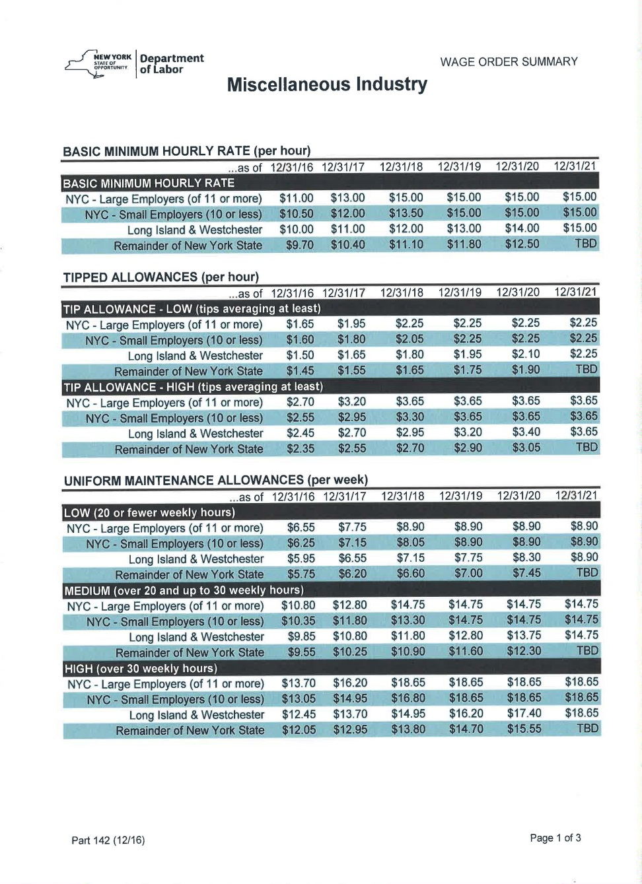
BASIC MINIMUM HOURLY RATE
(per hour)

Slide 61
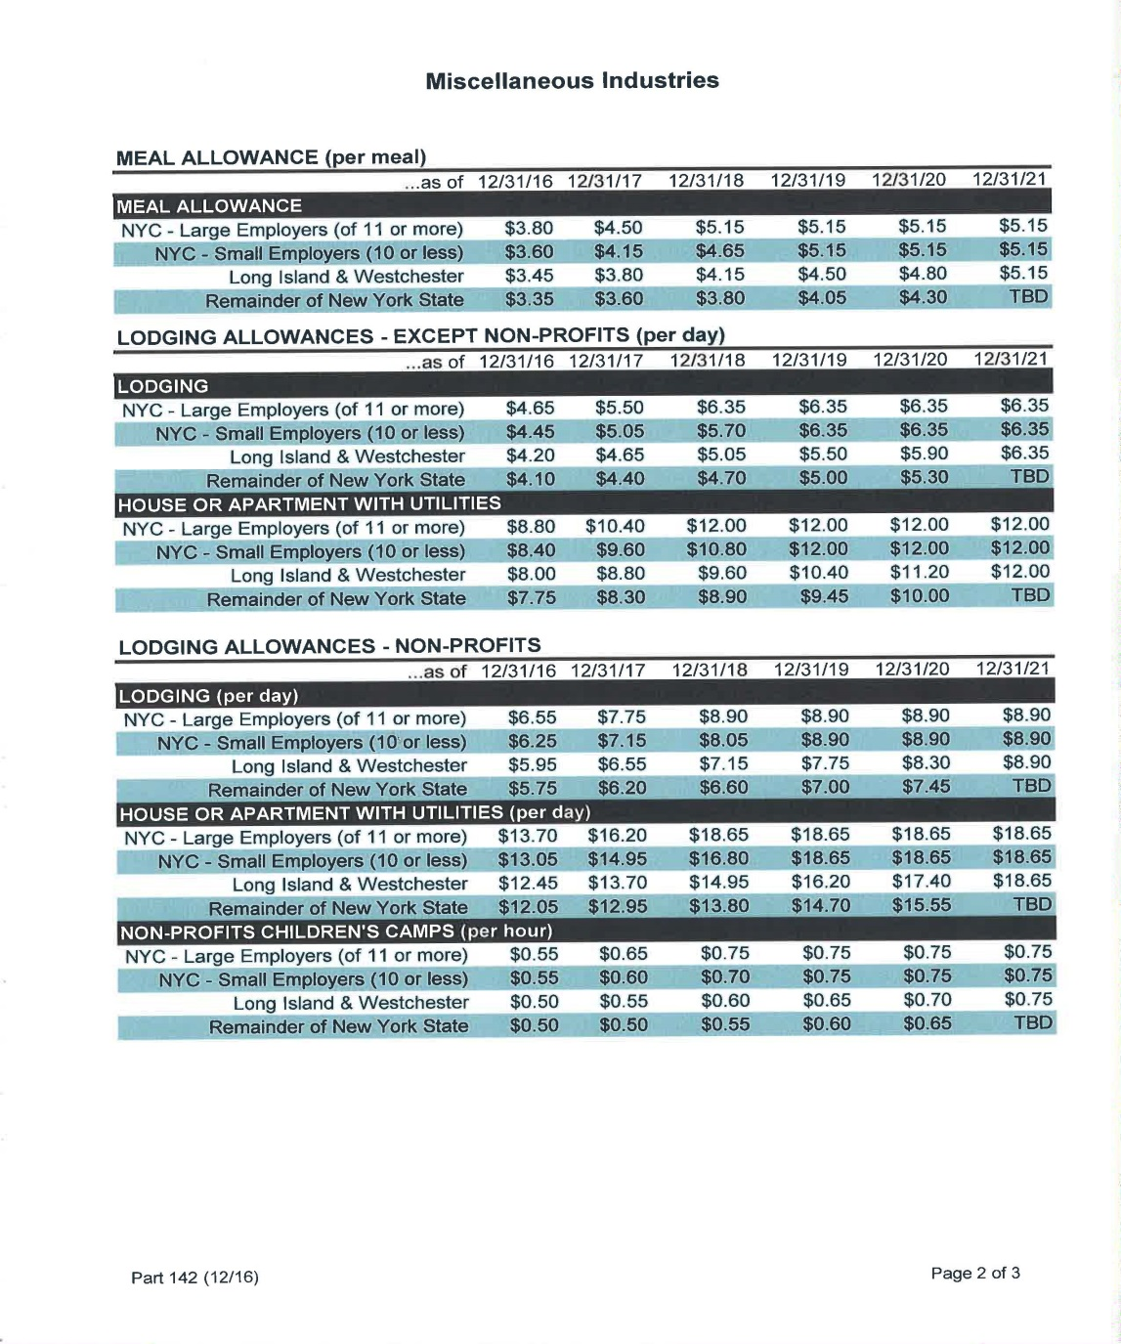
ALLOWANCES

Slide 62
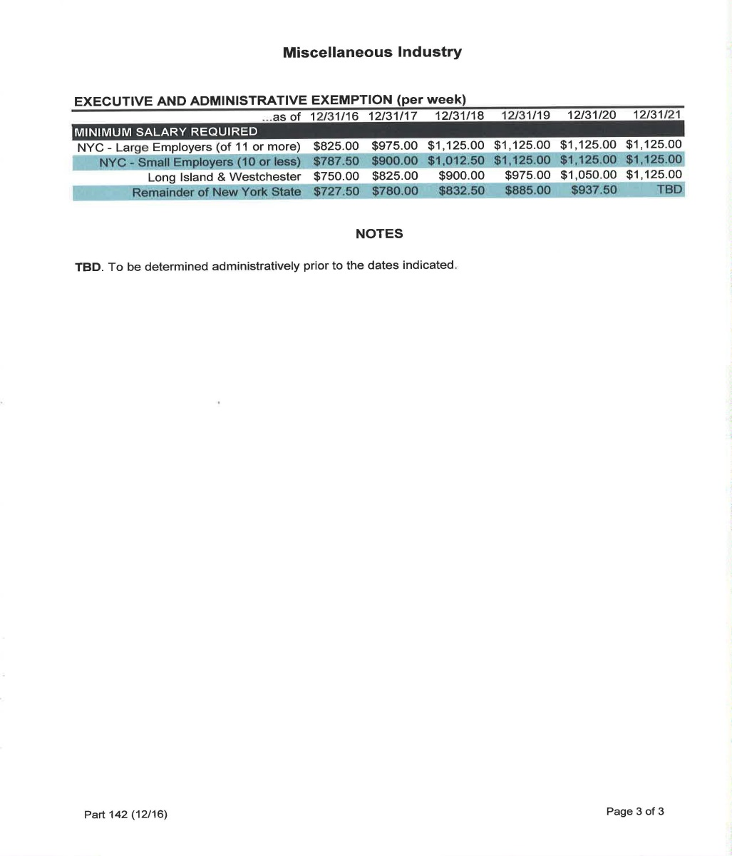
EXECUTIVE AND ADMINISTRATIVE EXEMPTION (per week)

Slide 63

QUESTIONS

Slide 64

I APPRECIATE YOUR TIME AND ATTENTION

