Slide 1

STRIKING THE PROPER BALANCE
Compensation Package that Satisfies Both the Rebbi & the IRS
Wednesday, June 28, 2017

Slide 2
Today’s Agenda
Introduction
QTR
Parsonage
Miscellaneous
Q & A

Slide 3
Legal Disclaimer
These handouts are for general information and educational purposes. Neither its distribution to any party nor any statement or information it contains is intended to or shall be construed as constituting legal or accounting advice. Readers are also cautioned that the information in this handout may not apply to all situations. Consequently readers should not rely on this handout or information it contains as a substitute for competent individualized legal or accounting advice about the specific circumstances of the reader.
IRS CIRCULAR 230 DISCLOSURE: To ensure compliance with requirements imposed by the IRS, we inform you that any U.S. federal tax advice contained in this communication (including any attachments) is not intended or written to be used, and cannot be used, for the purpose of (i) avoiding penalties under the Internal Revenue Code or (ii) promoting, marketing, or recommending to another party any transaction or matter addressed herein.

Slide 4

The balancing act
Rebbeim Administration

Slide 5

Rebbeim have spent years building a delicately balanced structure of salary and programs.

Slide 6
Before we start:
The Basics on Wages & Taxes
WAGES
Income tax
Tax bracket %
FICA (SE Tax)
15.3%
7.65% employer
7.65% employee

Slide 7
I. Qualified Tuition Reduction (QTR)
A tax-free reduction in tuition provided to an employee or certain relatives of the employee at a qualified institution.

Slide 8
  A completely tax free benefit
    No FICA tax
    No income tax
    Not reported on W-2
    Not reported on the tax return
MOST IMPORTANT POINT!
  QTR is a fringe benefit
  NOT a salary reduction
  Requires a properly worded contract
    Salary + QTR
    X QTR in lieu of salary
  Improperly worded contract can result in IRS reclassifying it as taxable income

Slide 9
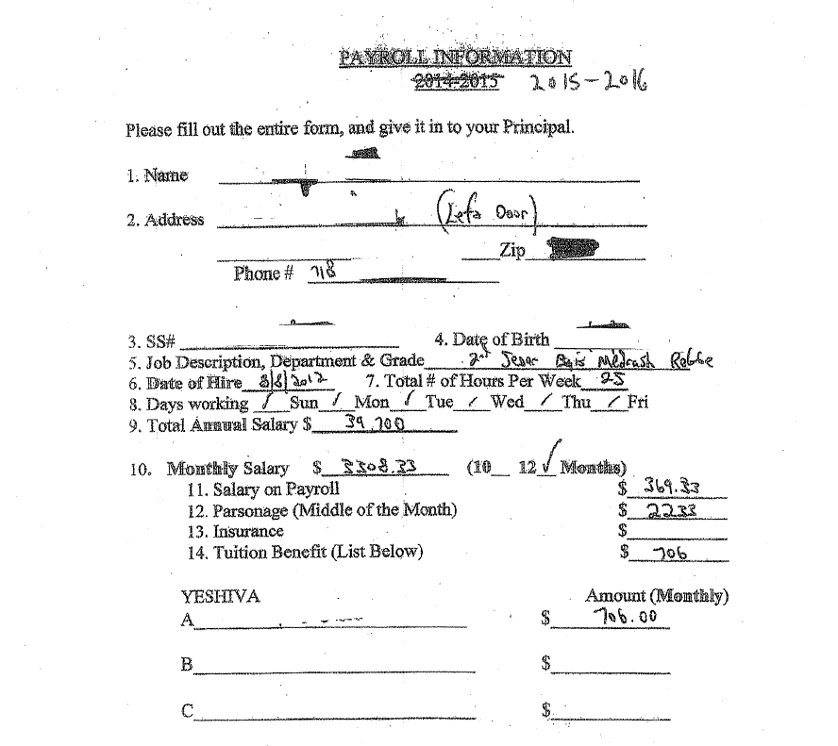
QTR
Right and wrong contracts:
CONTRACT
The School hereby agrees to pay the Teacher an annual salary of $50,000, made up of $30,000 salary and $20,000 in parsonage payments.
Additionally, the School will provide a QTR benefit of $__________ for qualified tuition of Teacher, spouse, or dependent children.

Slide 10
QTR (cont.)
Getting it right
  Properly worded contract
  Salary + QTR (not in lieu of)
  Beware of reducing salary
  Can’t discriminate
  Can set limits among classes of employees
    Years of service
    Hours (FT vs PT)
    Level of Responsibility
Reducing salary example
  Year 1:
    Salary $35K
    QTR $5K
        40K total
  Year 2: (Rebbi has additional child in school)
    Salary $30K
    QTR $10K
        $40K total
  IRS may construe QTR as taxable salary

Slide 11
Best Practices for QTR
Recommended QTR best practices:
  Set a minimum salary
  Annually increase QTR instead of salary
  Works well with lifecycle
  If possible avoid salary reduction, but if it is necessary, justify it in writing
  Document your decisions
Rebbi A:
  Salary $25K
  QTR $10K (2 kids in school)
Rebbi B:
  Salary $35K
  QTR $-0- (no kids in school)
It appears QTR is in lieu of salary
Justify & document higher salary to Rebbi B

Slide 12
QTR (cont.)
  Some Rules of QTR
  Children or spouse
  Other schools
  Seminaries & Yeshivos in Israel
  ? Playgroups
  Non dependent children, relatives
  Rebbi’s grocery bill, cc bill, etc
What is the max % of salary that can be designated as QTR?

Slide 13
II. Parsonage
Housing Allowance for Clergy members
A clergy member does not pay income tax on income he spends on housing

Slide 14
Parsonage
Parsonage allowance is limited to the lesser of:
a) the actual amount the Rebbi spent on housing
b) the FMV of Rebbi’s housing costs

Slide 15
Parsonage (cont.)
Who is a clergy member?
  Rebbi
  Morah
  English teachers?
  Secretaries?
How to set up parsonage:
  Official Designation of payments requires BOTH
    Board approval
    Employment agreement
  Signed parsonage form
  Include a Tax Disclaimer

Slide 17
Parsonage (cont.)
Eligible housing expenses:
  Mortgage/rent
  Garage rent
  Down payments
  R/E Taxes
  HO Insurance
  Utilities
  Repairs/improvements
  Furniture, décor, appliances, etc
  Ineligible housing expenses (cont.)
  Cleaning lady
  Groceries
  Car expenses

Slide 18

  PARSONAGE
  No school verification of housing expenses
  Checks to 3rd parties?
  Max % of salary?
  2 jobs?
  Down payment on house?
  Major repair or renovations?

Slide 19

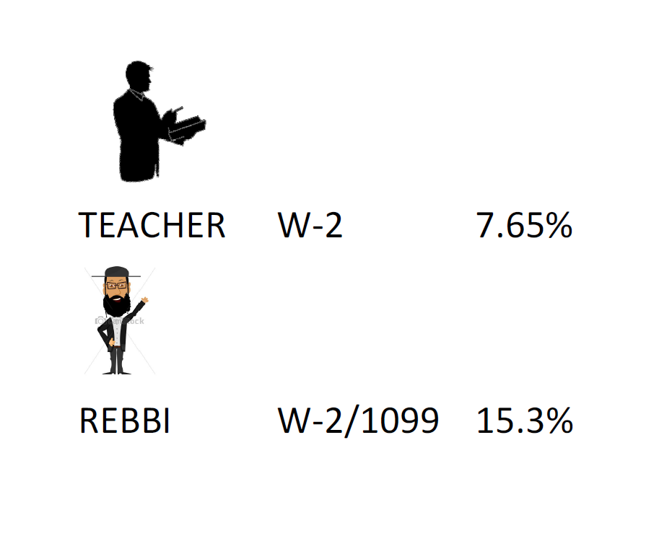
WARNING TECHNICAL ALERT!
How parsonage is taxed and how to report it
Recall: Income tax + FICA tax
  Reporting clergy member income on W-2
    With parsonage designation, Rebbi is considered self employed
    Rebbi’s entire salary now subject to 15.3% FICA tax (same as self employed-1099).

Slide 20
Parsonage (cont.)
Clergy W-2 explanation
  Total salary package 40K
  Parsonage portion 10K (30K+10K)
  Reports 30K on W-2 box 1 only
  FICA 15.3% tax on 40K= $6,120
  Rebbi loses $2,295 (30K x 7.65%)
  School may add $2,295 to salary to compensate Rebbi for additional tax
  That $2,295 counts as additional income and is added back to the W-2

Slide 21
Regular W-2 vs Clergy W-2
Reported as a regular W-2
  Total salary package 40K
  Parsonage portion 10K (30K+ 10K)
  Reports regular wages of 30K subject to FICA taxes
  Rebbi pays $2,295 of FICA like any “regular” employee

Slide 22
Clergy W-2 continued
So what’s wrong with leaving the W-2 as a regular one? Doesn’t the IRS get their FICA tax either way? Why complicate things?

Slide 23


Taxes- Does it make sense to take parsonage?
  Original intention of the law
    50K salary (25K parsonage)
    0 dependents
    No parsonage $9,372
    With parsonage $7,431
  How it applies to a Rebbi
    50K salary (25K parsonage)
    10 dependents
    No parsonage $3,825
    With parsonage $5,738

Slide 24
IV. Miscellaneous
Other compensation that may not be taxable

Slide 25
Miscellaneous Other Compensation
Bonuses before Yom Tov
Simcha fund for Rebbeim
Reimbursements (auto, travel, supplies, etc)
  Accountable plan
  Documentation
Dependent Care Benefit (DCB)
  Up to 5K excl. from gross income
Health Insurance

Slide 26
Reporting the Income
On your tax return (1040)
QTR No
Parsonage No*
Reimbursements No
Charitable gifts No
Kollel Checks Yes
*Reported on Schedule SE only
For Programs
Depends on the program
  Medicaid in NJ (MAGI)
  Lunch program
Income Verification Letters
  Carefully worded
  Full disclosure
  A. Rebbi _______ receives W-2 wages of $_______ per year.
  B. Rebbi _______ receives salary of $____ per year along with QTR of $ _______ and parsonage of $______etc.

Slide 27
Thank you for joining!
Feel free to contact me with any questions
info@hutmancpa.com
(732) 961-6272

